Slide 1
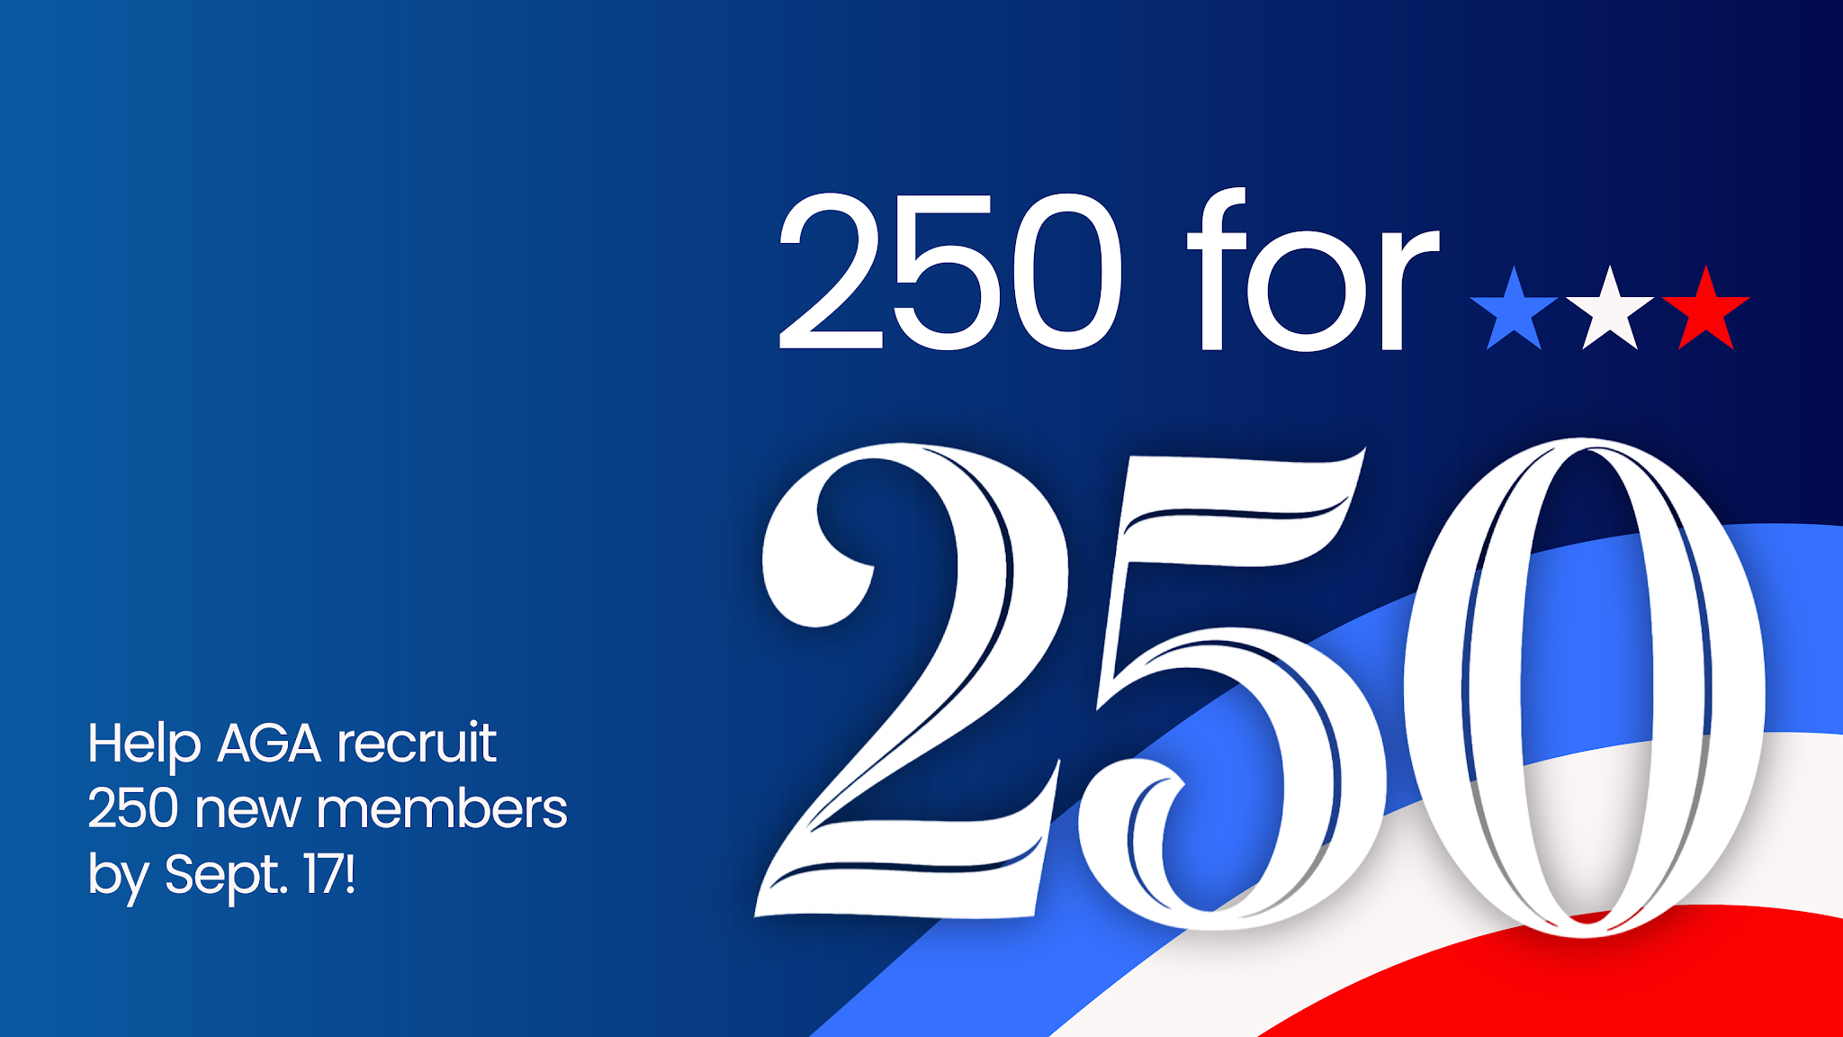


Slide 2
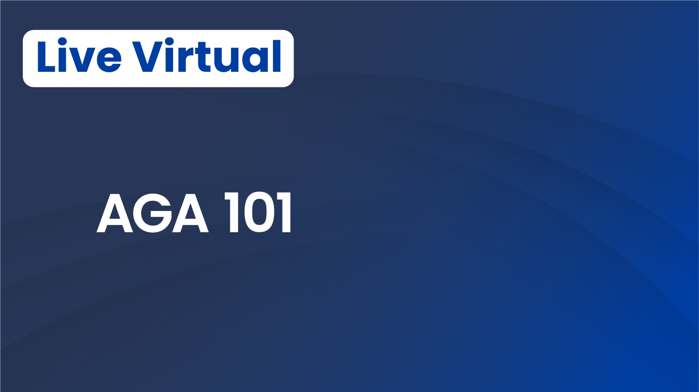
https://www.agacgfm.org/webinar/aga-101/
September 10, 2 p.m. ET
Considering joining AGA? Longtime member and want a refresh on your benefits? No matter where you are in your journey, you’re invited to join this brief info session.

Slide 3

What makes finance uniquely hard to lead through disruption
Leadership under sustained operational uncertainty
Atisha Burks | AGA National Treasurer

Slide 4
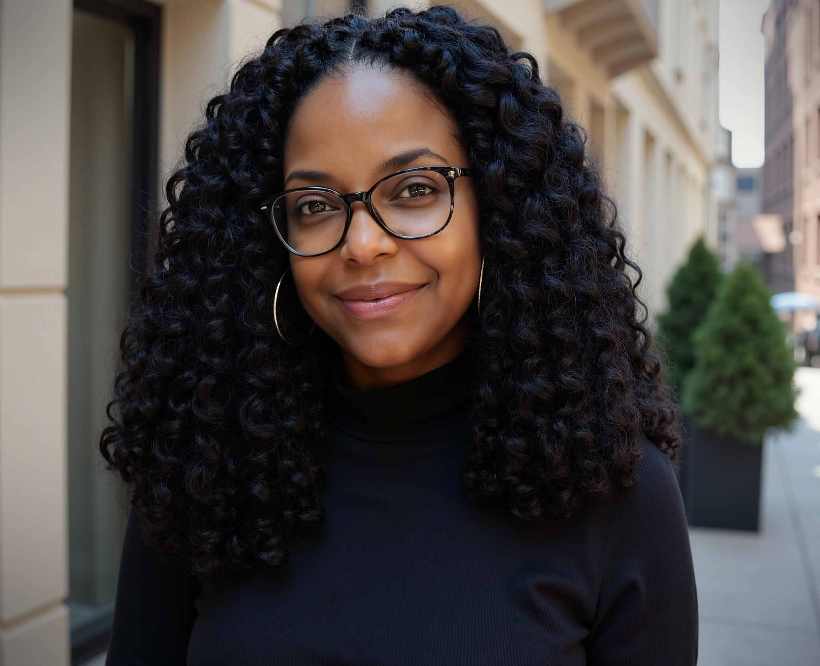
About the Speaker – Atisha N. Burks
Atisha Burks is the Founder and Principal of AnchorPoint Rising LLC, a fractional CFO/COO Ms. Atisha Burks is the founder of AnchorPoint Rising LLC, where she advises organizational leadership on financial and operational processes, identifies data gaps, standardizes the workflows, and builds the analytics layer.
Ms. Burks brings more than 20 years of senior federal executive leadership experience in financial management, reporting, and policy. Most recently, she served as Chief Financial Officer for the Federal Protective Service (FPS), where she oversaw financial management, acquisitions, and risk management operations.
Prior to her role at FPS, Ms. Burks held several senior leadership positions across the federal government, including Senior Leader for Financial Operations with the Department of the Navy, Chief of Financial Reporting, Policy, and Property with the U.S. Coast Guard, and Director of Financial Reporting and Policy at the U.S. Department of Commerce. In these roles, she led initiatives to strengthen financial reporting, internal controls, and policy development across large and complex organizations.
AGA National Treasurer
Atisha Burks

Slide 5
What We're Covering Today
Opening
What Breaks First
What Leaders Have to Do
Discussion + Close
Why this is the environment now — not a phase
Decision quality, trust, and institutional memory
Real moves, not management theory
What are you doing when it shifts again?

Slide 6
Opening | 0–10 min
This is not a change management talk.
Change management assumes disruption is temporary. We are in sustained operational instability.
Your audit cycle doesn't pause. Your internal controls don't reset. Your team is watching every signal you send.
The leaders who come out of this with stronger teams are the ones who led through it — not around it.

Slide 7
Why Federal Finance Is Uniquely Hard Right Now
Numbers don't move
with the org chart
Authority and responsibility
get decoupled
Pressure from
both directions
Apportionment, audit cycles, internal controls — all still due. Restructuring doesn't grant extensions.
You're still accountable for outcomes your team may no longer control. That gap is your problem to manage.
Political pressure above. Operational pressure below. Your team is watching to see if you flinch.

Slide 8
What Breaks First |
01
Decision Quality
People stop making calls when they don't know who has authority anymore. Decisions get escalated, delayed, or avoided. The mission still needs decisions.
02
Trust
Teams start managing up instead of managing the work. They're reading your signals, not running the function. Silence from leadership gets interpreted as either ignorance or concealment.
03
Institutional Memory
The people who knew why the system works the way it does leave — and nobody built a system to catch it. Audit history, control rationale, program budget logic: gone.

Slide 9
What You Actually Have to Do |
Name the uncertainty out loud
Your team will fill the silence with something worse than the truth.
Protect the function, not just the structure
The org chart can change. Audit readiness, close processes, and internal controls still have to work.
Make smaller, faster decisions
Don't wait for clarity that isn't coming. A directional decision now beats a perfect decision in 6 weeks.
Know what didn't change
Anchor your team to what is still true. That's where stability comes from when the structure isn't providing it.

Slide 10
When Formal Authority Gets Unclear
Title doesn't carry as far in disruption. Credibility does.
How you showed up in the last crisis is your actual resume with this team, not your job description.
→
Peer relationships across agencies become load-bearing. Your network isn't a nice-to-have when the formal structure is shifting.
→
The person who can translate financial reality to non-financial leadership during a crisis becomes indispensable fast.
→
Credibility transfers across agencies. (ex: track record at Coast Guard followed me to DHS).
→

Slide 11
What This Means — Depending on Where You Sit
Early-Career Professionals
Senior Leaders
Disruption accelerates visibility. People get noticed faster when things are hard.
The instinct to wait for clarity before acting is exactly wrong. (That doesn’t mean overstepping!)
Start building institutional knowledge now. It becomes your currency when others don't have it.
Your network is an asset you build before you need it.
Your team is reading every signal, including the ones you don't mean to send.
Protecting your people doesn't mean pretending things are fine. It means giving them enough truth to make good decisions.
The leaders who come out with stronger teams led through disruption, not around it.
Silence from leadership always gets interpreted as something.

Slide 12
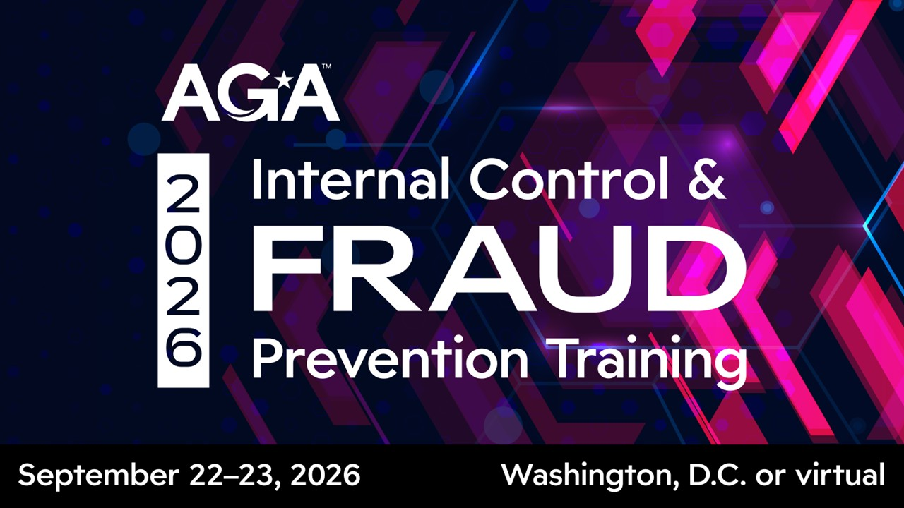

Slide 13
Discussion |
The question to close on:
What are you doing right now so your team can function if the ground shifts again next month?
Discussion prompts:
Where in your function are decisions getting stuck and is that a process problem or an authority problem?
Who on your team is building institutional knowledge, and who is consuming it?
When did you last tell your team the truth about the environment and what did you leave out?

Slide 14
Quick Reference | Leading When the Ground Keeps Moving
WHAT BREAKS FIRST
WHAT TO DO
BUILD NOW
Decision quality
Trust
Institutional memory
Name the uncertainty
Protect the function
Make smaller decisions
Anchor to what's still true
Cross-agency relationships
Institutional knowledge systems
Your credibility track record
Questions to stay with:
Where are decisions getting stuck and is that a process problem or an authority problem?
What must keep working no matter what changes?
Who on your team is building institutional knowledge, and who is consuming it?
What knowledge, risk, or pressure is currently sitting with one person?
When did you last tell your team the truth about the environment?
Where are decisions slowing down because authority is unclear?
Atisha Burks | AGA National Treasurer

Slide 15
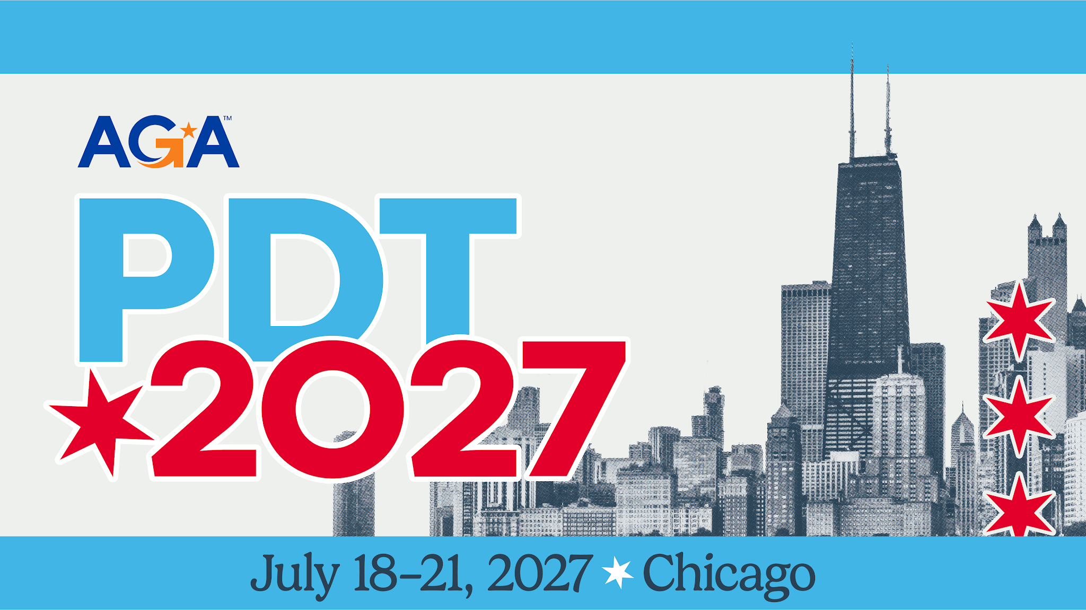

Slide 16


